Slide 1
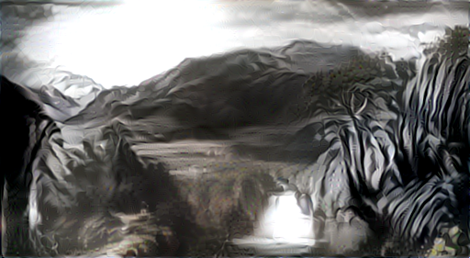
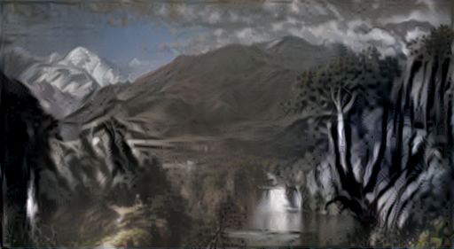
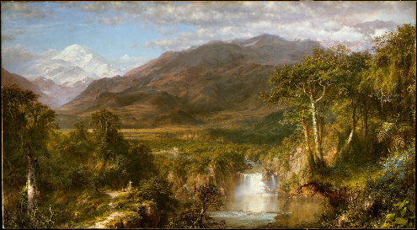
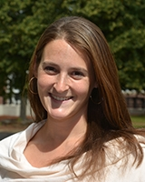

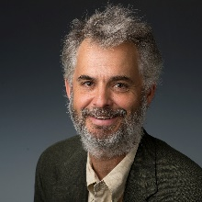
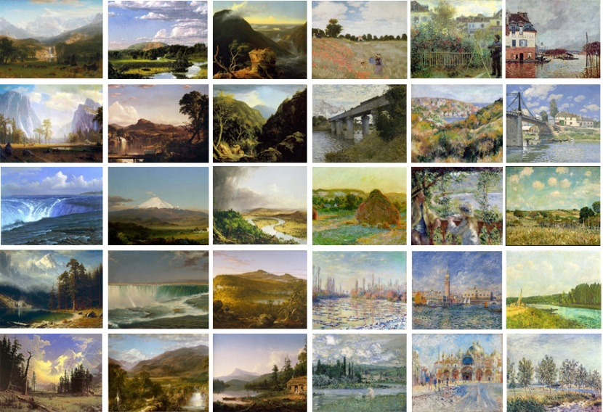
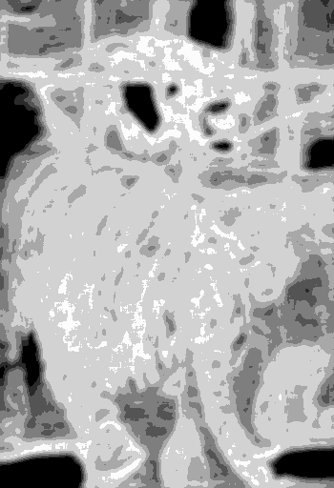
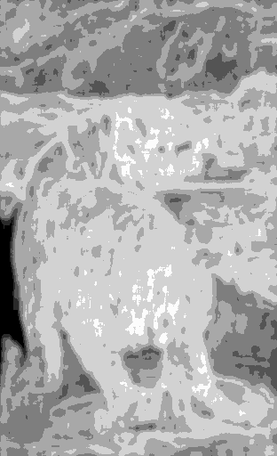
Making WAIVS!
Digital Image Analysis, Philosophy & the Arts
Catherine A. Buell
Mathematics Department
Fitchburg State University
Ricky J. Sethi
Computer Science
Fitchburg State University
W. P. Seeley
Philosophy Department
University of New Hampshire
Bates College

Slide 2
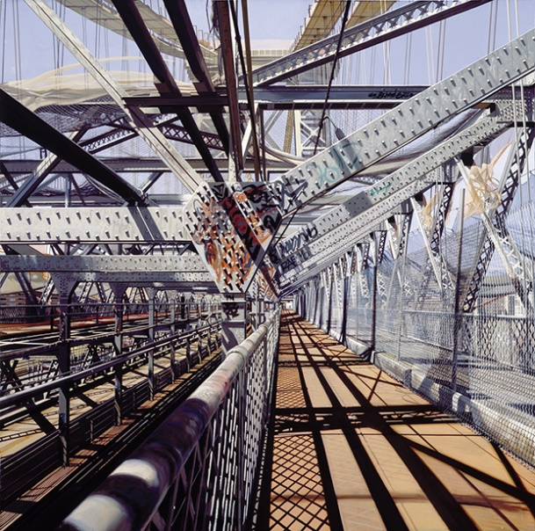
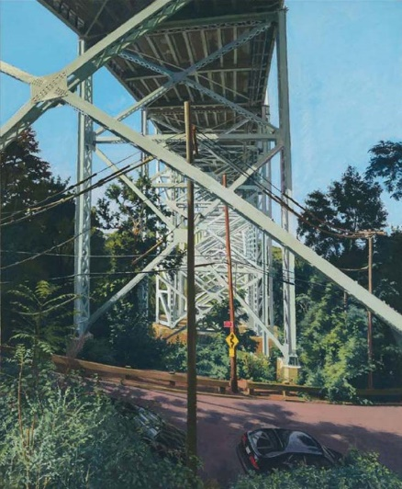
Richard Estes
Williamsburg Bridge (1995)
Rodin Museum, Paris
Rackstraw Downes
Henry Hudson Bridge Substructure, A.M.
Addison Gallery of American Art

Slide 3
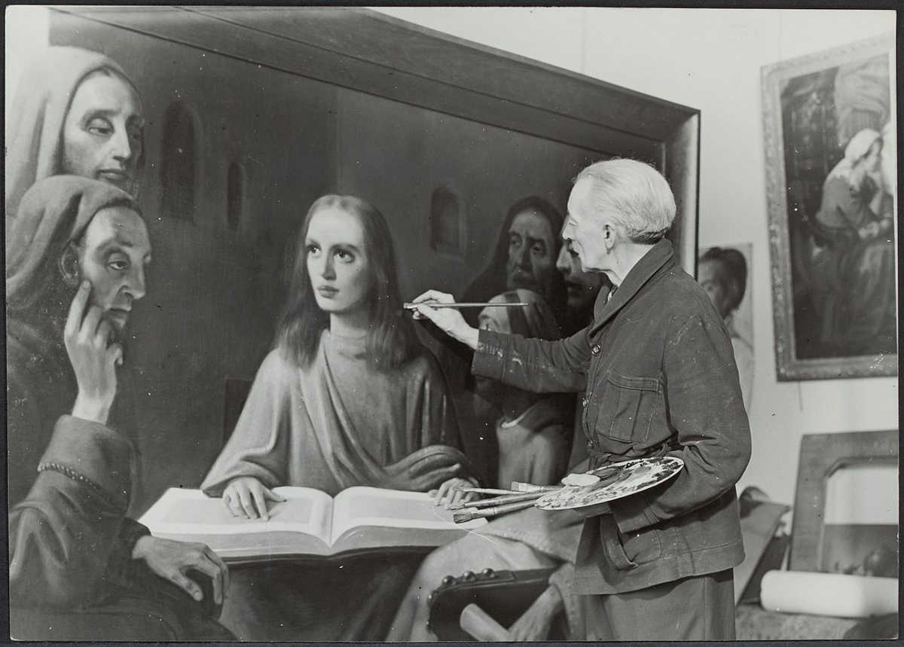
Interdisciplinary Goals
Digital image analysis tools for arts related disciplines
  use the power of big data to study the nature of artistic style
  mine image statistics to explore the results of classification research
  assumption: categories of art = artistic style = image statistics
    brushstrokes, textures, contours, palette, tonal values, composition, iconography

Slide 4
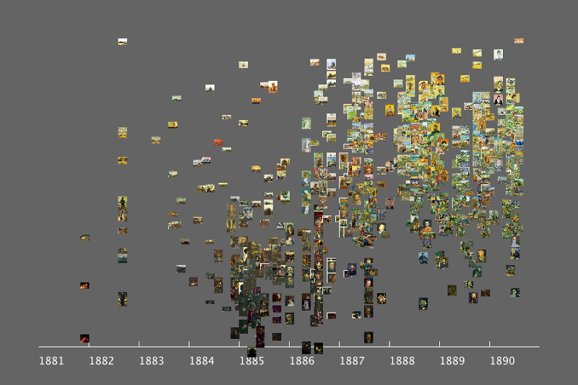
Lev Manovich (2010). Style Space: How to compare image sets and follow their evolution.
Published on softwarestudies.com, retrieved May 19, 2017: http://manovich.net/index.php/projects/style-space

Slide 5
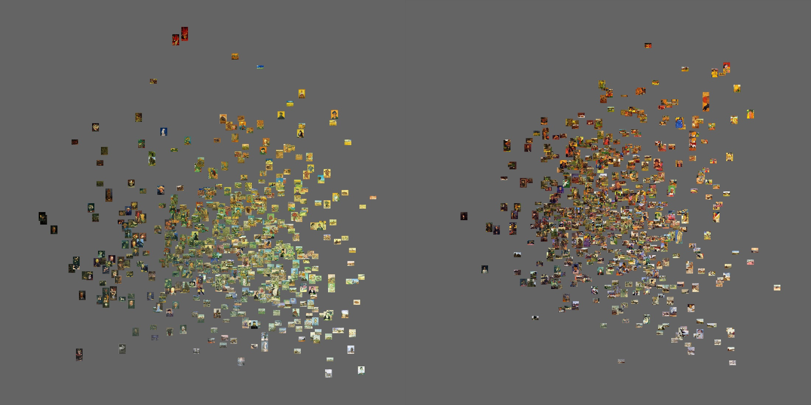
Left: 580 van Gogh paintings
Right: 580 Gauguin paintings
X = brightness (median)
Y = saturation (median)
https://www.flickr.com/photos/culturevis/6063737678/in/album-72157627389144448/

Slide 6
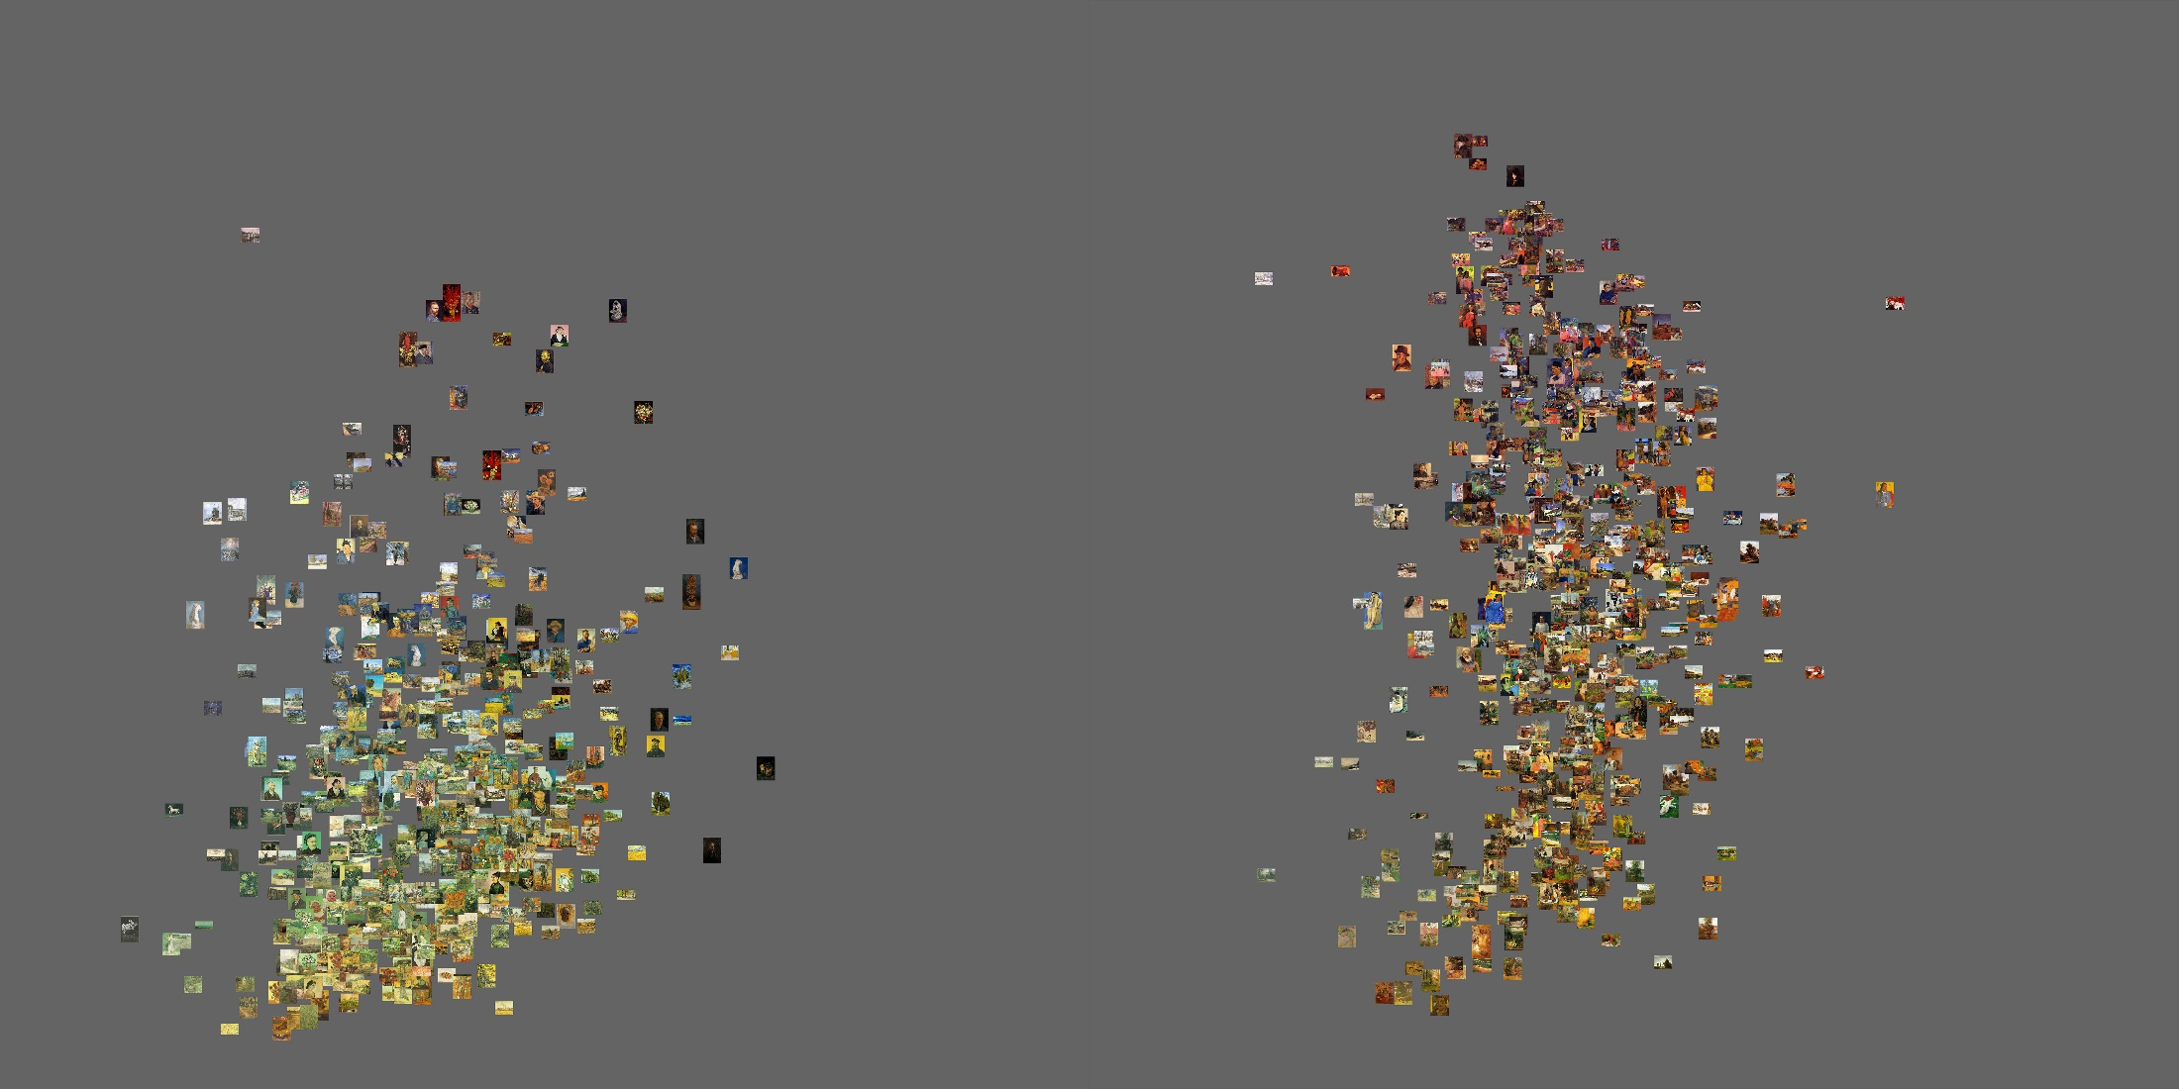
Left: 580 van Gogh paintings
Right: 580 Gauguin paintings
X = saturation (standard deviation)
Y = hue (standard deviation)
https://www.flickr.com/photos/culturevis/6063189299/in/album-72157627389144448/

Slide 7
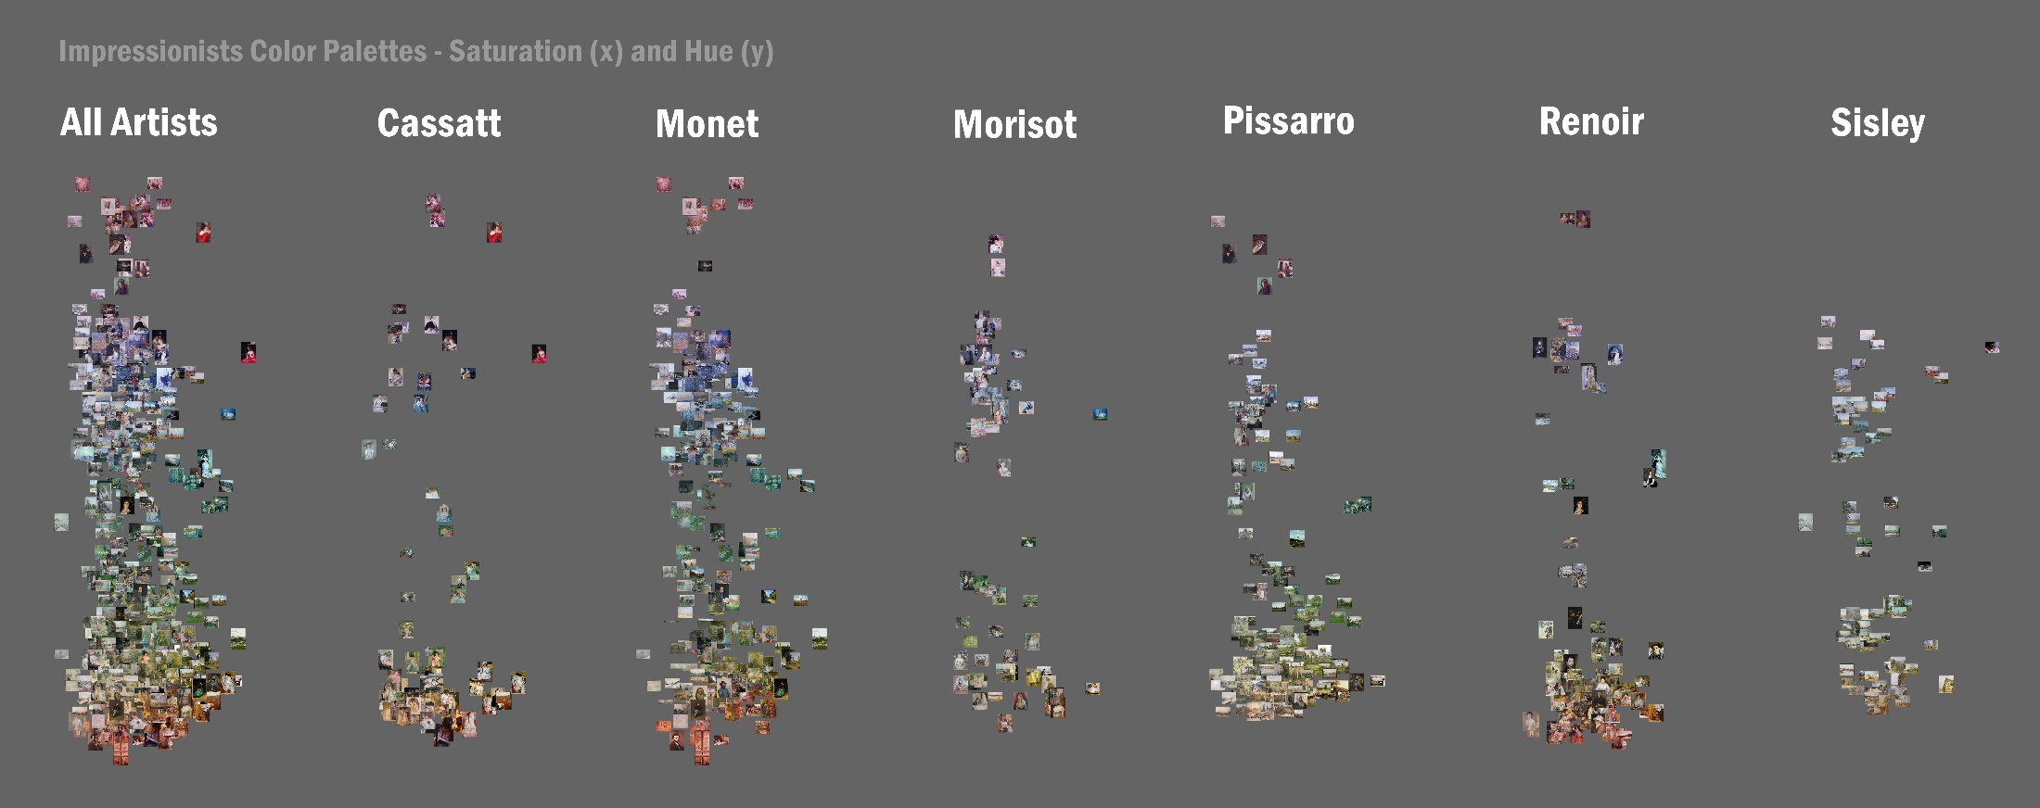
630 paintings
X-axis = median brightness.
Y-axis = median hue.
https://www.flickr.com/photos/culturevis/6915522520/

Slide 8
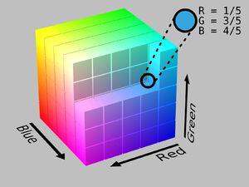
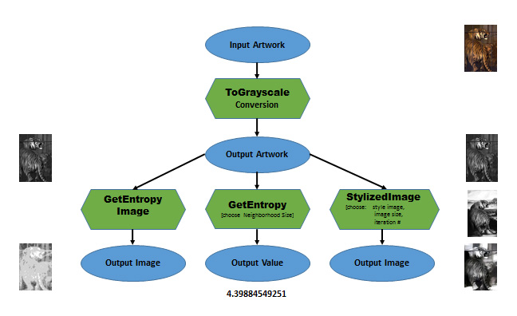
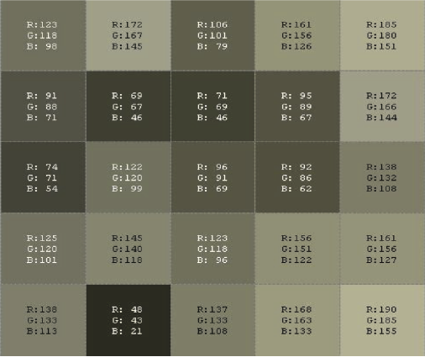
Interdisciplinary Goals
Computational literacy & STEAM
  use familiar analyses of familiar objects to introduce students in the humanities to STEM related concepts.
    entropy, standard deviation,
    the structure of digital images, color reproduction in digital images
    some understanding of the elements of programming

Slide 9
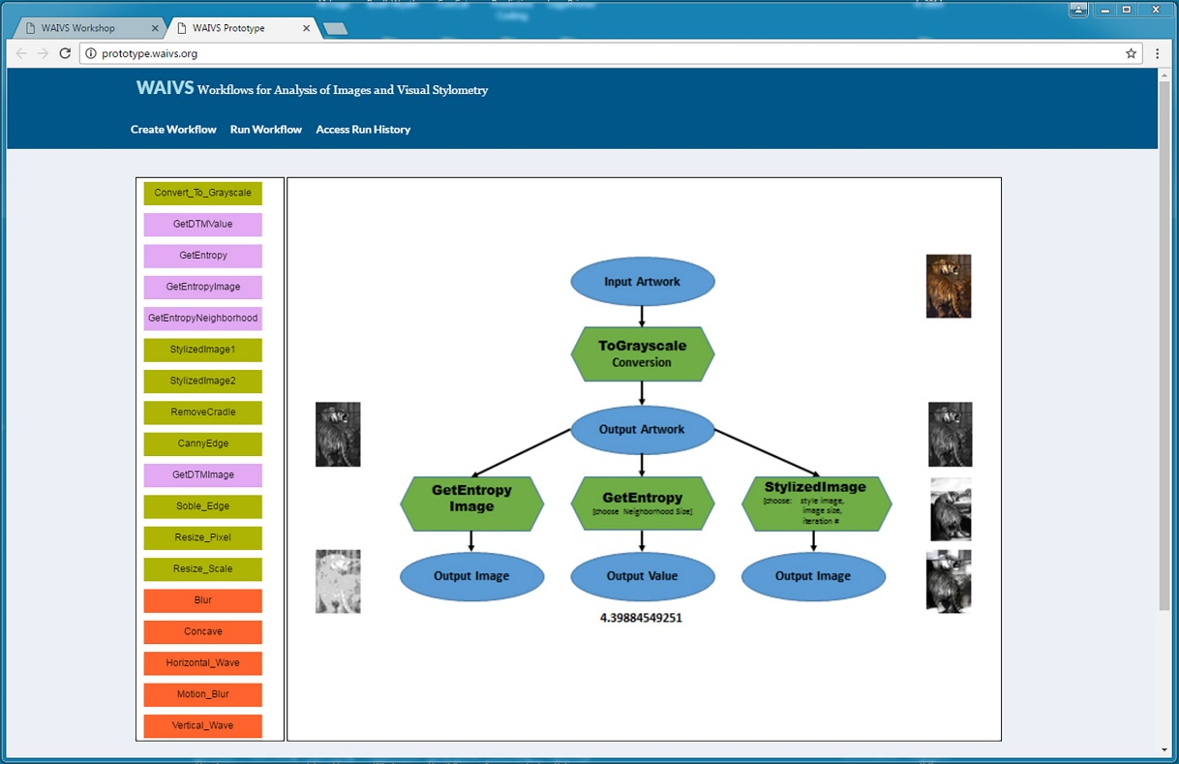

Slide 10
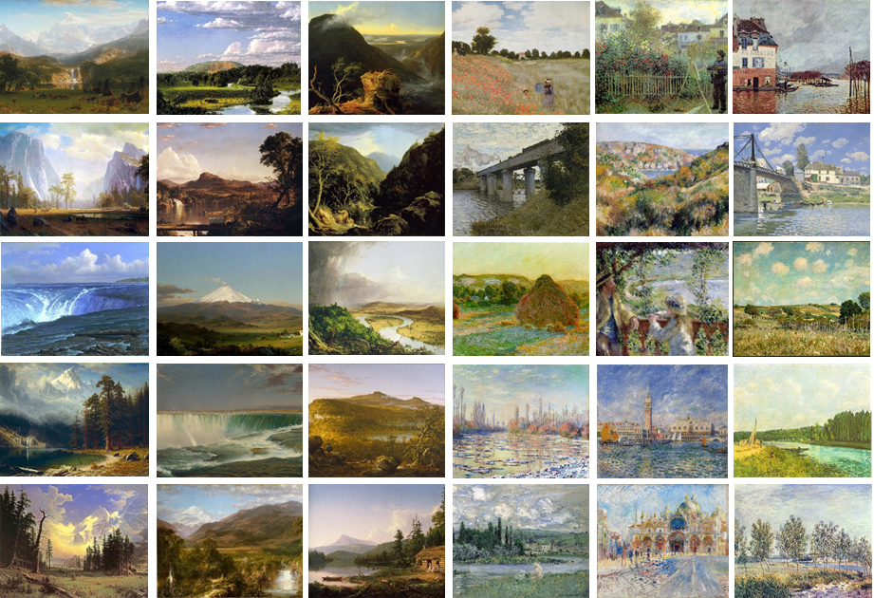
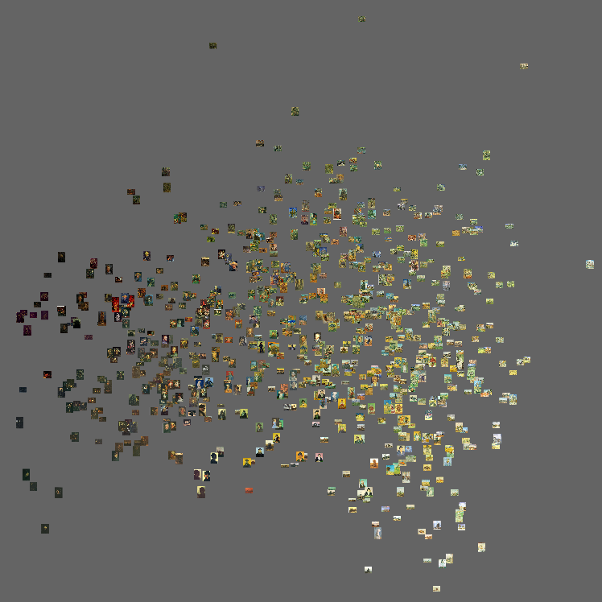
Interdisciplinary Goals
Cognitive Science
  visual recognition
    image statistics, diagnostic features, categorization
    60 million inputs/year (3/second)
    accumulated information
    some regularities are more likely than others…categories of art
dataset: 776 van Gogh paintings
400 features extracted using custom batch digital image processing software
this visualization: PCA 1 and PCA 2

Slide 12
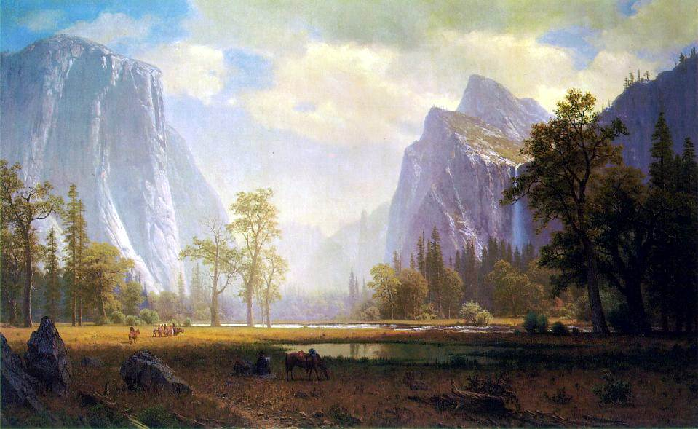

Slide 13
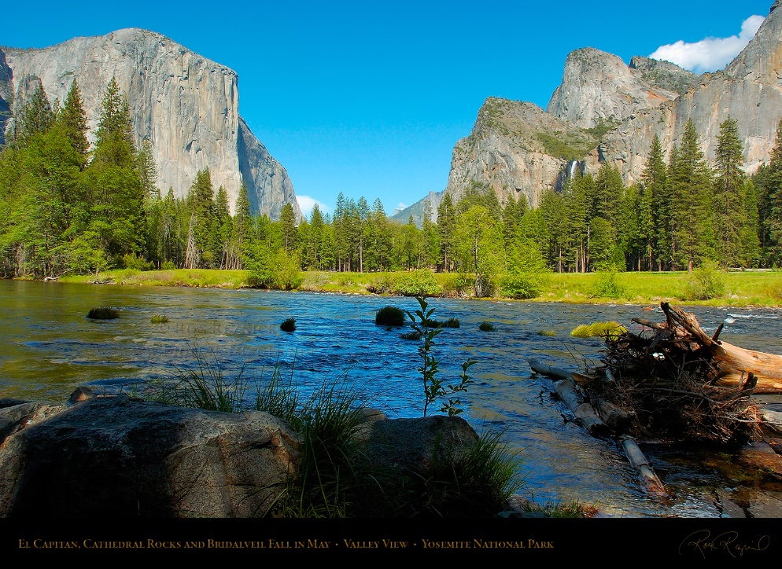

Slide 14
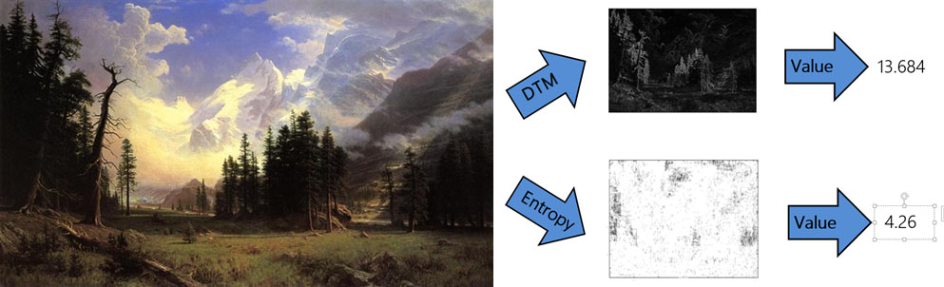

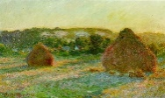
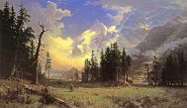
This research is supported by a Natural Endowment for the Humanities Digital Humanities Startup Grant (HD-248360-16) and an American Society for Aesthetics Major Projects Initiative Grant.

Slide 15
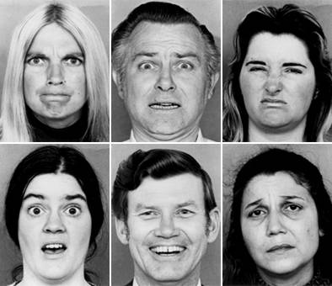
Diagnosticity
Diagnosticity spatial frequency information
Schyns, Gosselin, & Smith (2008)
Schyns, Petro, & Smith (2009)
Bonnar, Gosselin, and Schyns, 2002

Slide 16
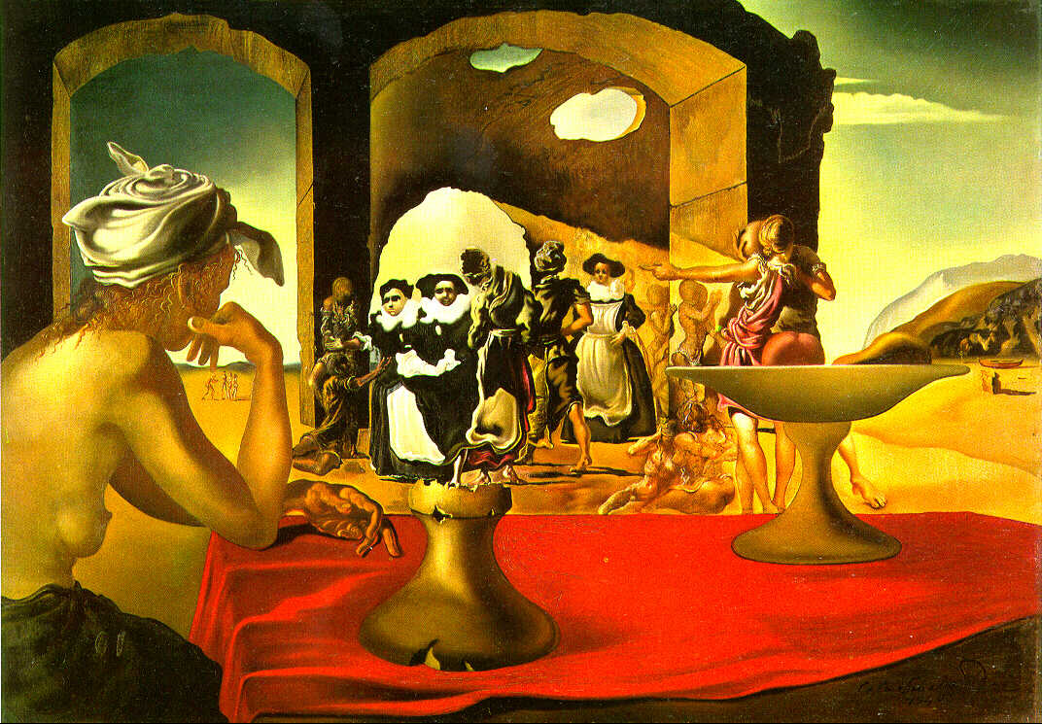
Diagnosticity
Dali, Slave Market with Disappearing Bust of Voltaire, 1940.

Slide 17
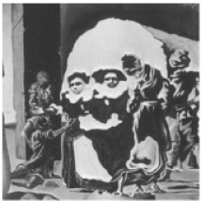
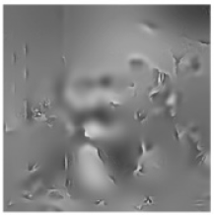
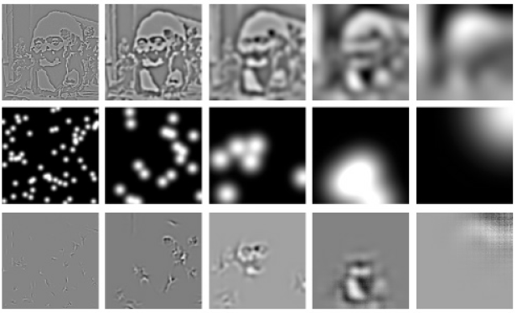

Diagnosticity
Diagnosticity spatial frequency information
bubbles (Bonnar, Gosselin, & Schyns, 2002; Gosselin & Schyns, 2001)

Slide 18
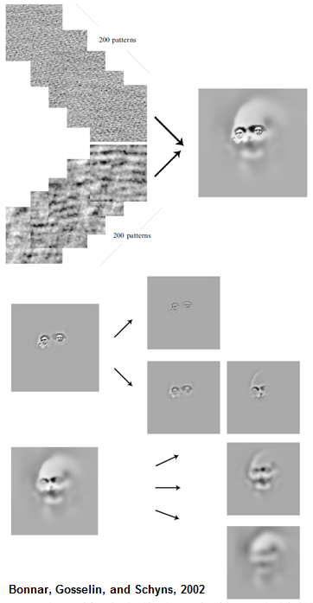
Diagnosticity
Diagnosticity
bubbles (Gosselin & Schyns, 2001)
frequency-specific adaptation (Bonnar et al 2002)
Bonnar, Gosselin, and Schyns, 2002

