Slide 1








An Introduction to Workflows and WINGS
Yolanda Gil
Information Sciences Institute
and Department of Computer Science
University of Southern California
http://www.isi.edu/~gil
@yolandagil
gil@isi.edu

Slide 2




Slide 3
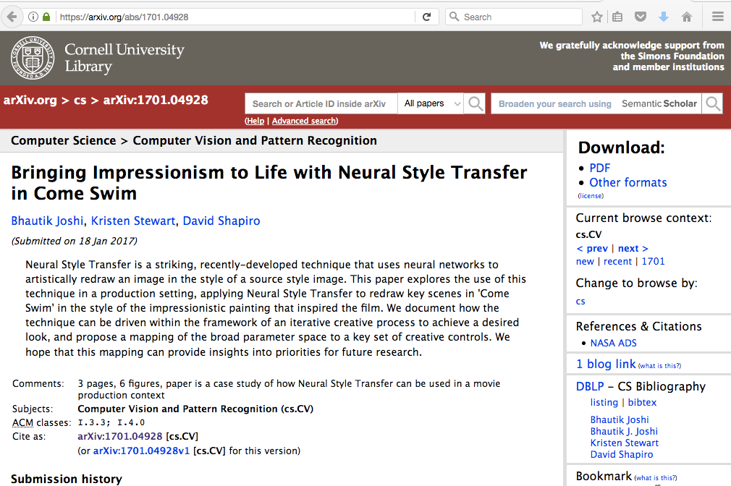

Slide 4
Topics
Computational workflows
Benefits of using workflows
Workflow systems
Semantic workflows

Slide 5
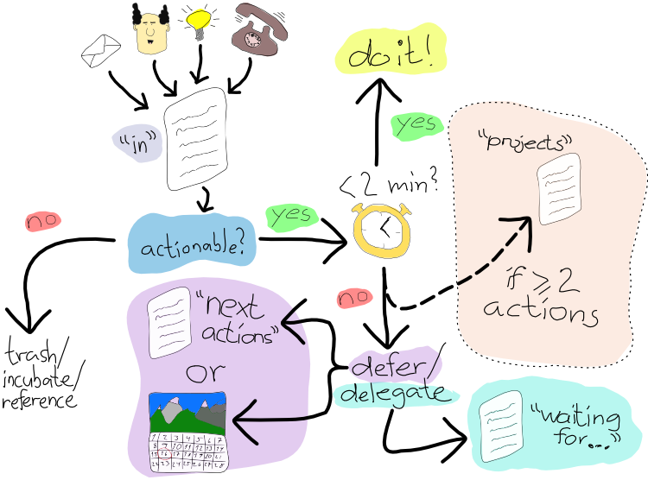
“Workflow” Is a Common Term to Denote Organized Activities
https://www.flickr.com/photos/atosorigin/11008571564

Slide 6
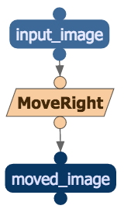

Treating Workflow Components as “Black Boxes”
You don’t have to understand the inner workings in order to use the component
This is why we often refer to software as a “black box”
You do need to understand inputs/outputs/parameters and the program’s function
RotateRight

Slide 7
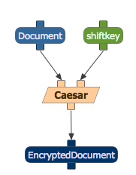
Components as Black Boxes
Original: BAD
Cipher: EDG

Slide 8
Software for Data Analysis
1) Commercial statistical packages
  SPSS
  SAS
  Stata
  MATLAB
  Mathematica
  …
  (Excel)
2) Open source (free) software
  R package
  Python libraries
  OpenCV for image processing
  NLTK for text processing
  …
3) Custom software
  Scripts
  Functions built by
  developers
  …
Can create workflow components by exposing a function (i.e., a command line invocation)

Slide 9
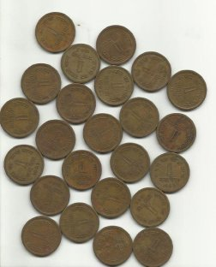
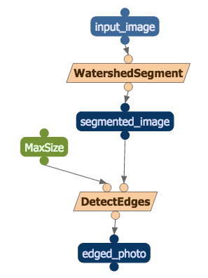

Segmentation
http://docs.opencv.org/master/d3/db4/tutorial_py_watershed.html

Slide 10
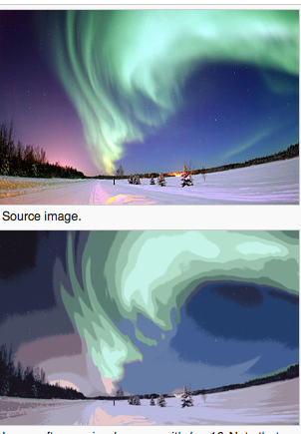
Segmentation
Dividing an image into regions
  Each region contains “similar” pixels
Useful for detecting objects
http://docs.opencv.org/master/d3/db4/tutorial_py_watershed.html

Slide 11

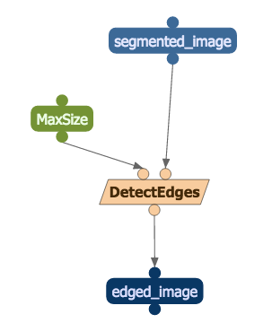
Edge Detection
https://en.wikipedia.org/wiki/Edge_detection#/media/File:%C3%84%C3%A4retuvastuse_n%C3%A4ide.png

Slide 12
Composing Functions
CompA
CompA
CompB
CompB
CompB

Slide 13
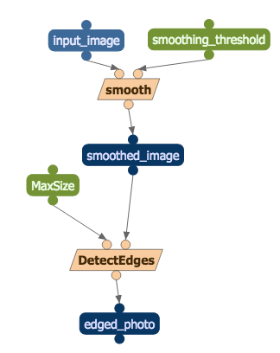
Computational Workflows
A computational workflow is a composition of functions implemented as software components

Slide 14
Topics
Computational workflows
Benefits of using workflows
Workflow systems
Semantic workflows

Slide 15


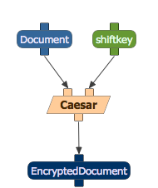
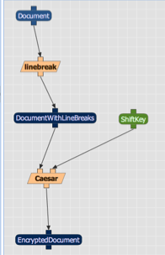
Simple Programming Paradigm
https://www.flickr.com/photos/pasukaru76/5571502641
https://www.flickr.com/photos/georgivar/5535049084

Slide 16
Many Compositions to Try

Slide 17
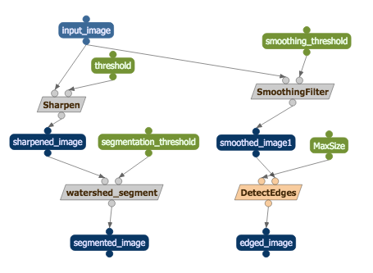
More Complex Compositions

Slide 18
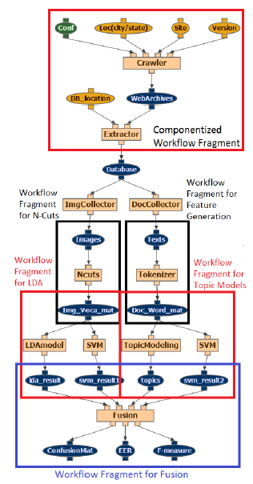
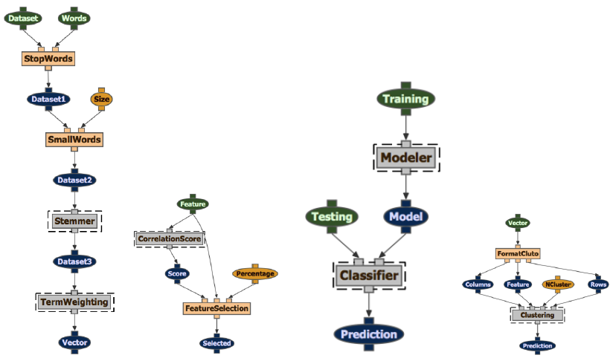
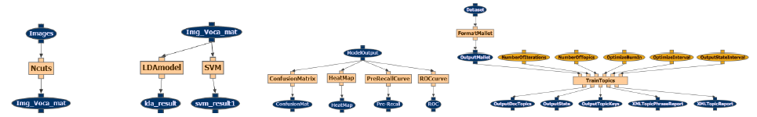
Modular Assembly
[Sethi et al MM’13]

Slide 19
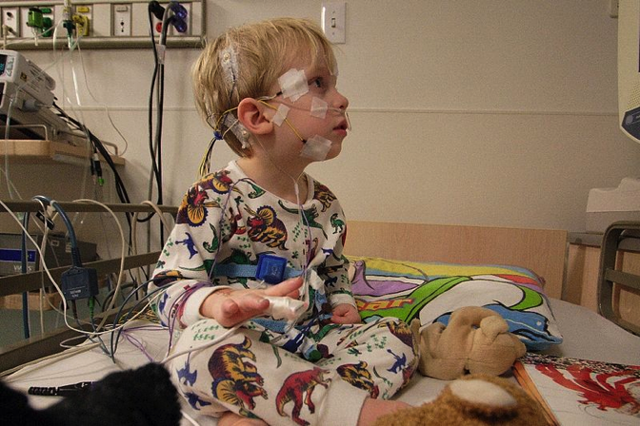

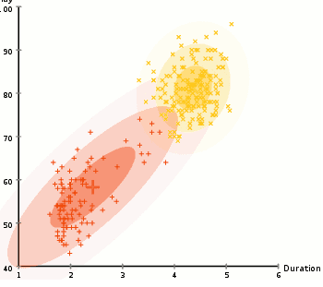
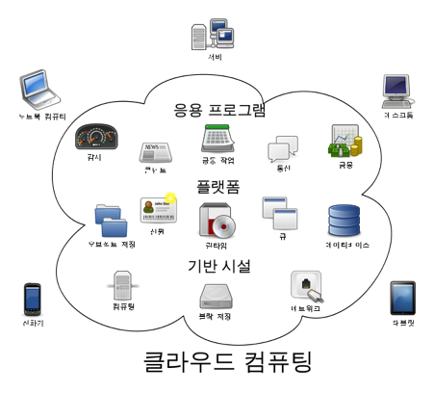
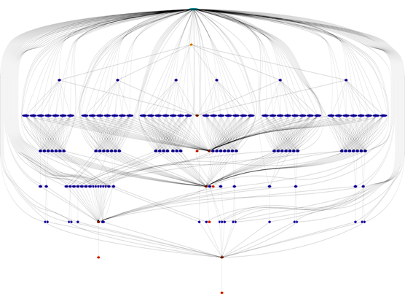






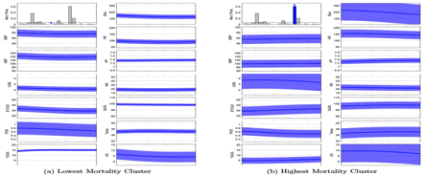
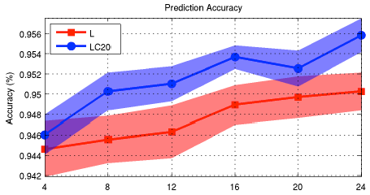


Facilitating Communication Across Data Science Expertise Areas
Describe problem
CODE
Provide data
Show results
Point out issues
Show more results

Slide 20


Data Science Teams:
1) The Domain Experts

Slide 21


Data Science Teams:
2) Semantics and Data Integration Masters

Slide 22

Data Science Teams:
3) The Math Whizes

Slide 23

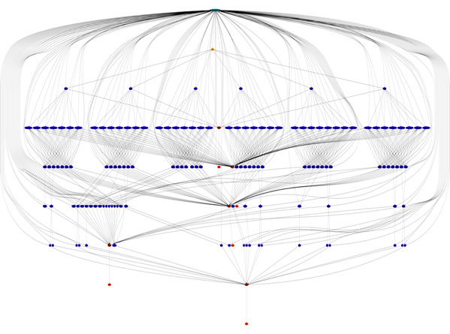
Data Science Teams:
4) The Scalability Hackers

Slide 24
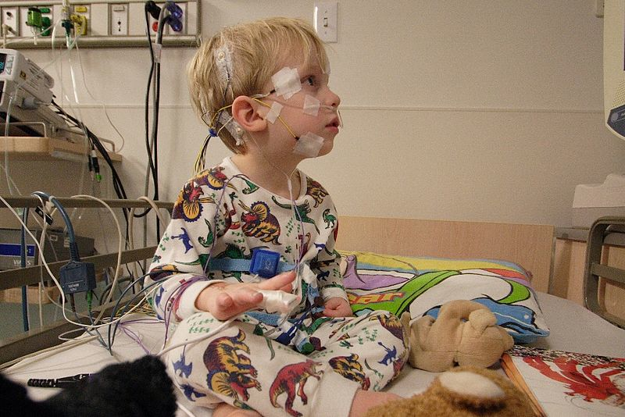

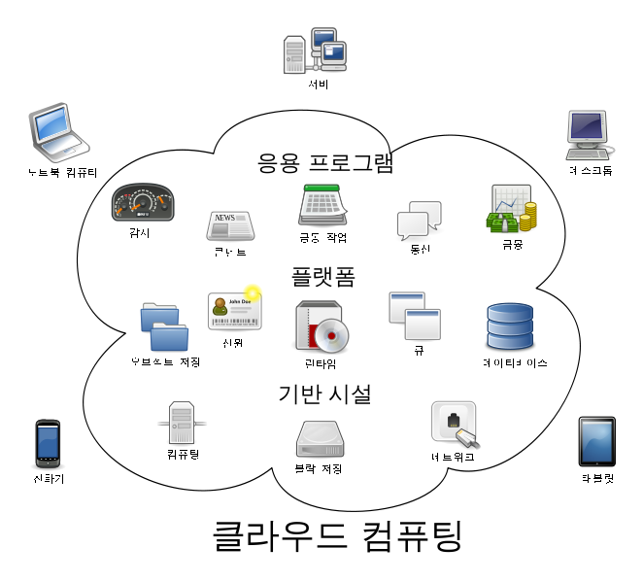
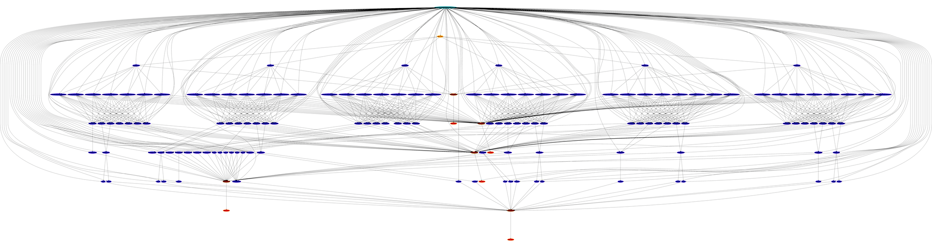
Distinct Expertise in Data Science
Domain knowledge
Statistics, data mining
Semantics and data integration
Large-Scale Data Processing

Slide 25
Facilitating Communication Across Data Science Expertise Areas
Describe problem
CODE
Provide data
Show results
Point out issues
Show more results

Slide 26
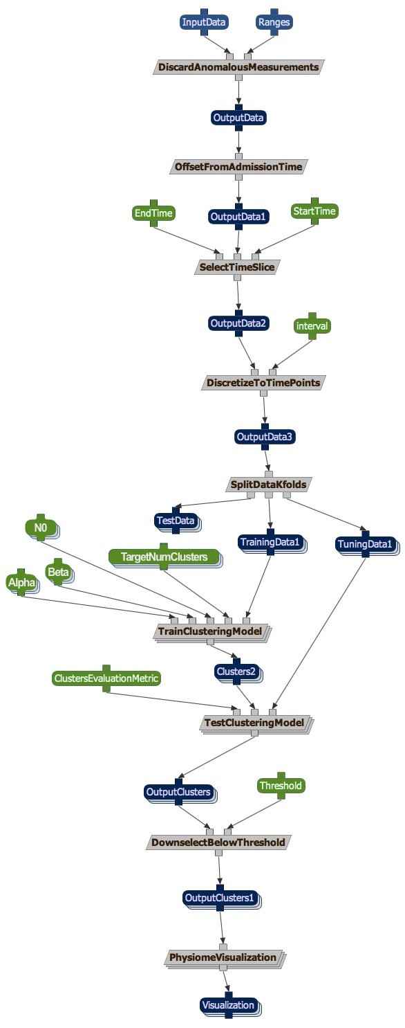
ICU Patient Clustering
[Marlin et al IHI’12; Kale et al ‘13]
End users can easily and continuously explore the data by running the workflow themselves, trying out different data and different parameter values
CODE

Slide 27
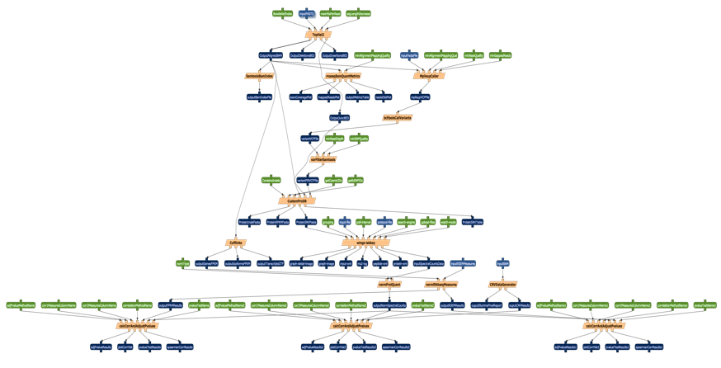
Benefits of Using Workflows
Simple programming paradigm
Modular assembly
Facilitating communication across data science expertise areas
Composing heterogeneous code
Data preparation steps
Data visualization steps
Provenance and reproducibility
Large-scale processing

Slide 28
Topics
Computational workflows
Benefits of using workflows
Workflow systems
Semantic workflows

Slide 29



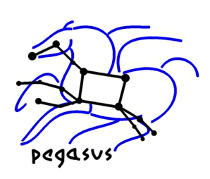










Workflow Systems
Many choices
  Academic prototypes
  Operational open source
  Commercial
Each has different capabilities
  Scalable computations
  Domain components
  Data visualizations

Slide 30
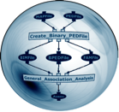

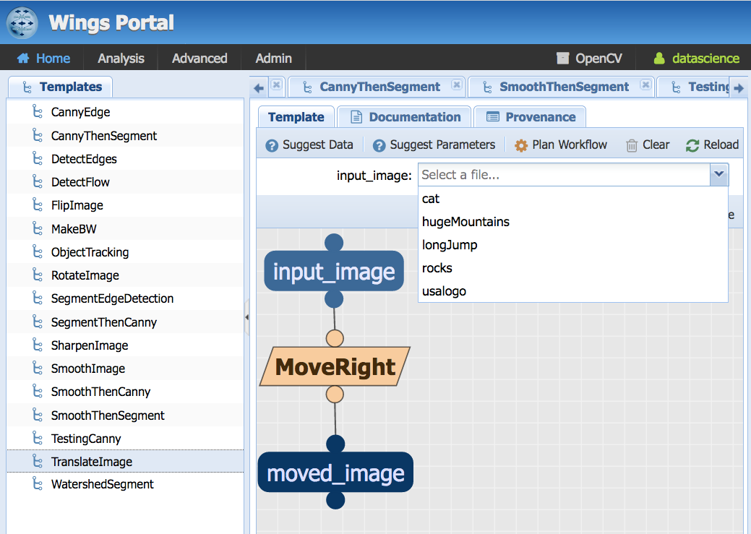
WINGS http://www.wings-workflows.org

Slide 31
Topics
Computational workflows
Benefits of using workflows
Workflow systems
Semantic workflows

Slide 32
Workflows Treat Software Components as “Black Boxes”
You don’t have to understand the inner workings in order to use the component
This is why we often refer to software as a “black box”
You do need to understand inputs/outputs/parameters and the program’s function

Slide 33
Sometimes There Are Important Constraints
Original: BAD
Cipher: EDG

Slide 34
Sometimes There Are Important Constraints
Shiftkey should not be 26
Original: BAD
Cipher: EDG

Slide 35
Sometimes There Are Important Constraints
Shiftkey should not be 26, or 0
Original: BAD
Cipher: EDG

Slide 36
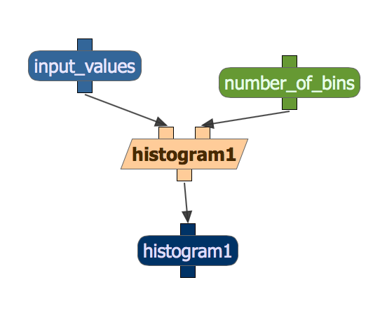
Semantic Components
Semantic components include semantic constraints that express logic rules about their input or output data, parameters, or other uses of the underlying code
Validation rule: Shiftkey cannot be zero
Parameter setting rule: Sturges’ rule suggests that number_of_bins be set to
log₂(number of data points) +1

Slide 37
Semantic Constraints
To Set Up Parameter Values
Fall-2016-Courses
Sturges’ rule:
bins = log₂(number of data points) +1
Metadata
Number of datapoints: 479
Semester: Fall
Year: 2016
Data
Course ID | Enrollment | Instructor | Open
549 | 20 | A. Gold | Yes
533 | 50 | D. Garcia | Open
556 | 25 | P. Peters | Y
521 | 100 | J. Smith | Open

Slide 38
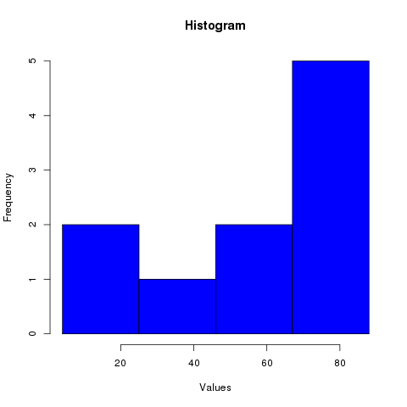
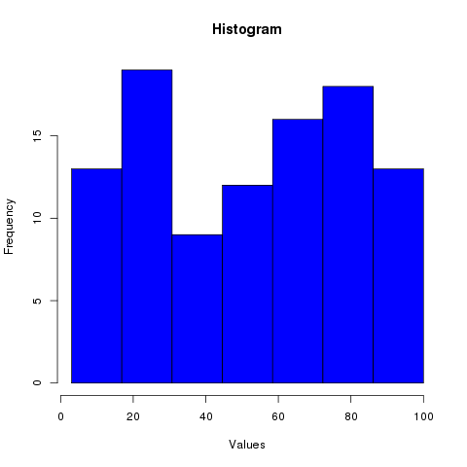
WINGS Customizes Workflows through Semantic Constraints
The data file for this histogram has 10 data points, so WINGS automatically proposes 4 bins:
The data file for this histogram has 100 data points, so WINGS automatically proposes 7 bins:

Slide 39
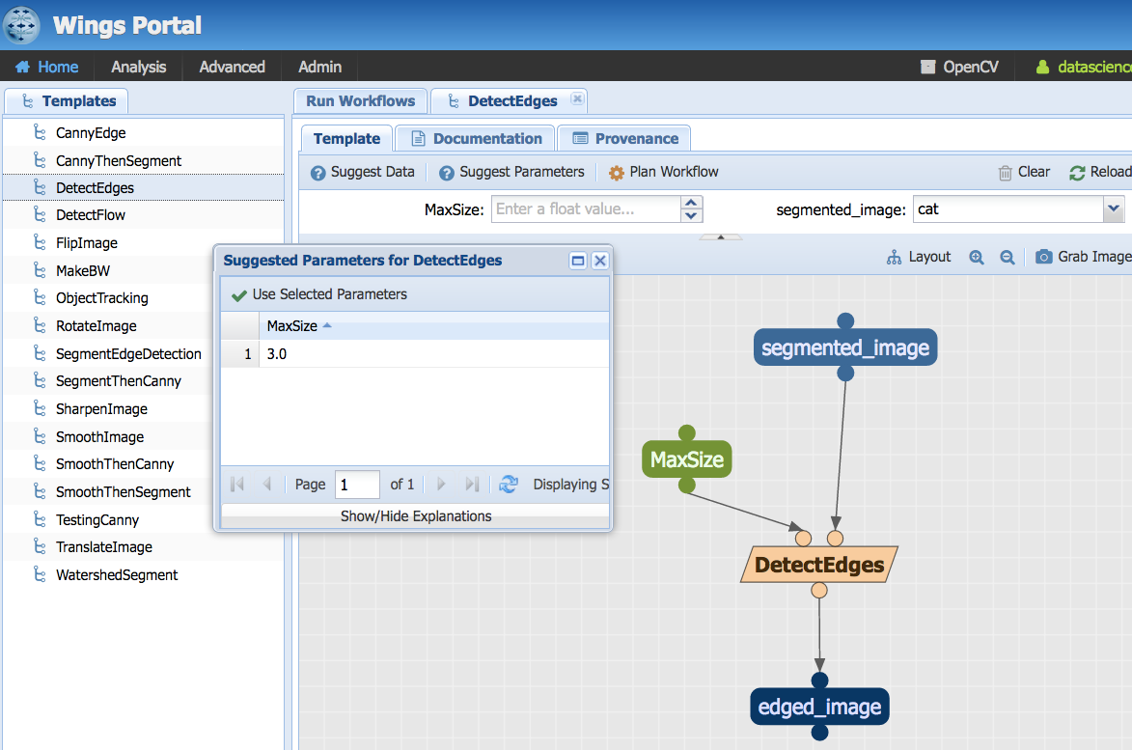

Slide 40
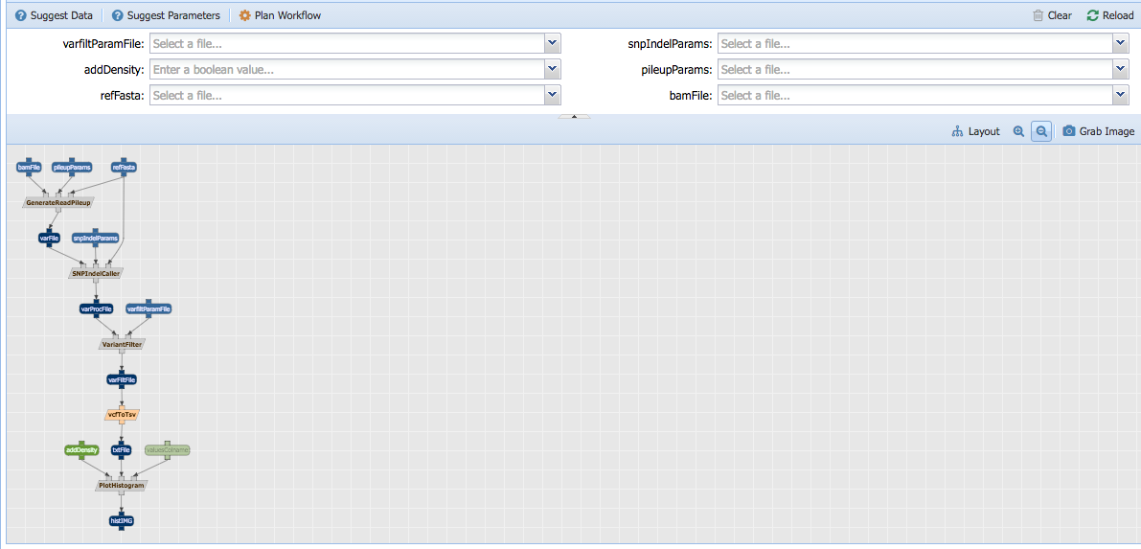
Summary: Semantic Workflows
Suggestions for parameter settings
Validation of workflow inputs based on workflow components
All tools and components in one click workflow
Notes:
Variant calling in Wings

Slide 41
Conclusions
Workflows are complex compositions of advanced data analysis software
Workflows make it easy for domain experts to use advanced analytic methods
Many workflow systems available
WINGS has additional capabilities to enforce important semantic constraints
http://www.wings-workflows.org

