Slide 1

Tool Demonstration and Hands-on Exploration

Slide 2
Getting Started...
Sign on to WIFI:
WIFI name: FAMGuest
Password: Norcross1
Go to the website in your packet (w#.waivs.org/wings-portal).
Click Login:
Username: fsuvs
Password: FSUvs2016
Select Run Workflows from the top menu.

Slide 3
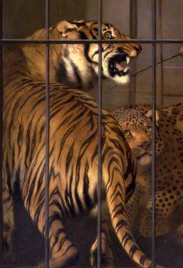
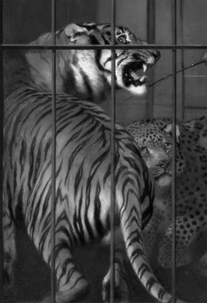
Intro: ToGrayscale & Uploading Pictures
Task 1:
Use the ToGrayscale workflow to turn Landseer’s Tiger from Color to Grayscale.
Task 2:
Upload this picture to the system.

Slide 4
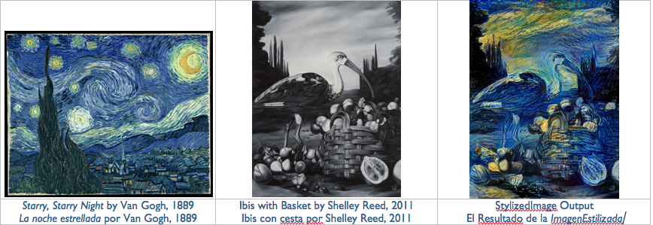
Experiment 1: Using Stylized Images & Entropy
Resources and explanations. Sample CNN and sample entropy

Slide 5
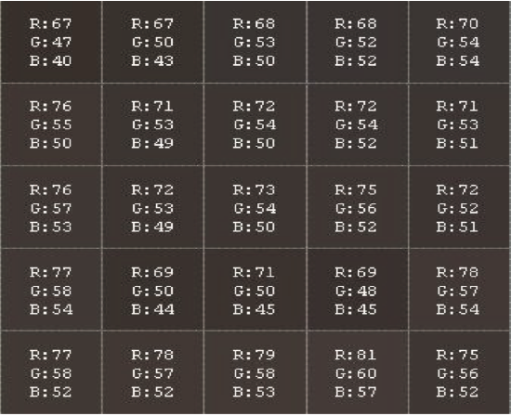
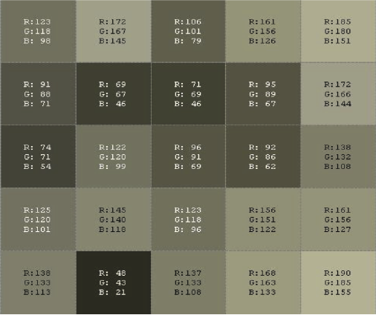
Pixel Analysis (Entropy)

Slide 6

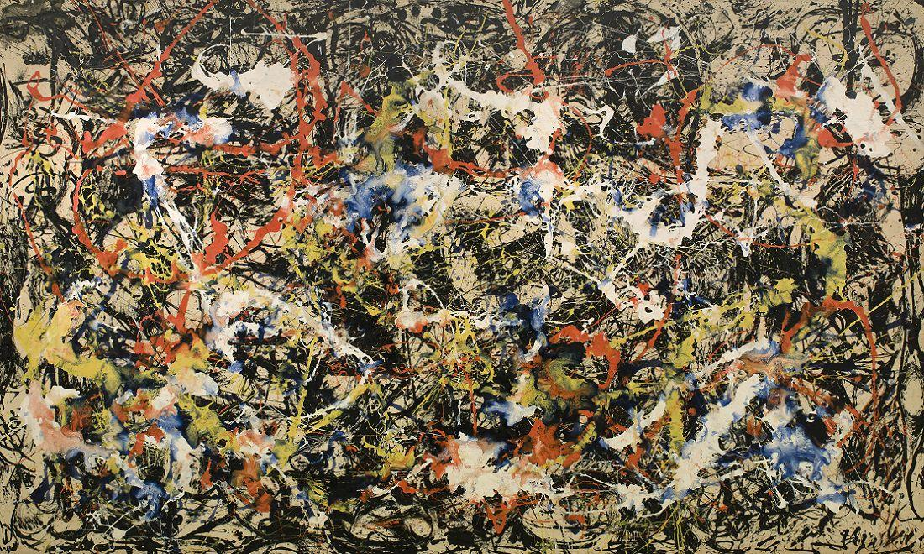
Experiment 1: Using Stylized Images & Entropy
Entropy measures how different the other pixels are in the area around a pixel.
In mathematical terms, it is a way to measure information contained in a painting as a measure of uncertainty. Or very mathematical terms, ∑p log₂(1/p).
0.652825109051
5.40867630854
Buell’s Divergence
Pollock’s Convergence

Slide 7
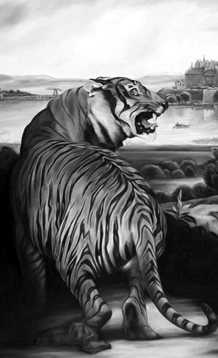
Task 1:
Apply Landseer-style
to Reed’s Tiger
Task 2:
Apply Reed-style
to Landseer’s Tiger
Landseer’s Tiger
(grayscale image)
Reed’s Tiger

Slide 8
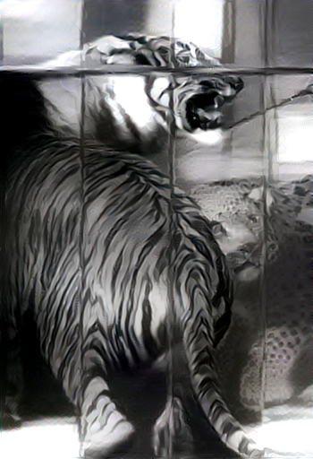
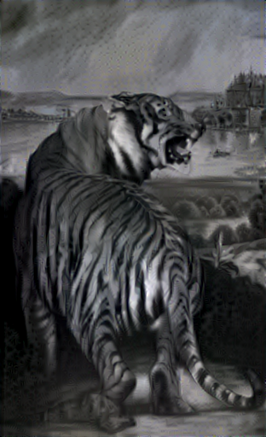
Landseer
(→ Reed)
Reed
(→ Landseer)

Slide 9
Entropy Images & Entropy Values
Task 1:
Compare Entropy Images (GetEntropyImage) for the two
transformed paintings.
Reeds style on Landseer.png and Landseer style on Reed.png
Task 2:
Compute Entropy Values for the images.

Slide 10

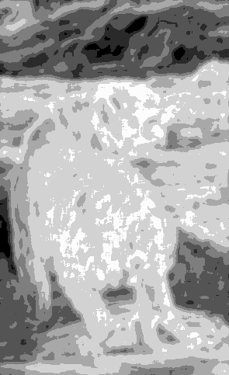
Landseer
Reed

Slide 11
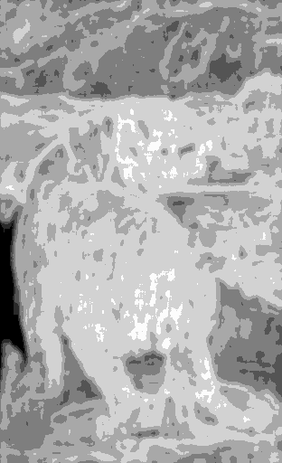
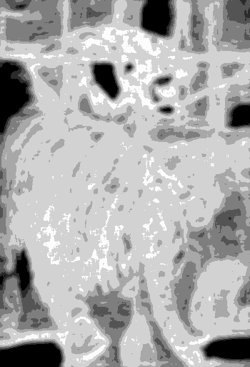
Landseer’s Style on Reed
Reed’s Style
on Landseer

Slide 12
Compute Entropy Values for 1 and 5

Slide 13
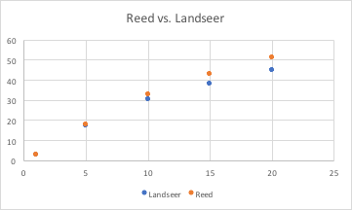
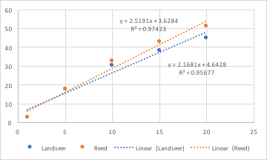
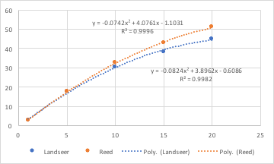

Slide 14
Pixel Analysis (Discrete Tonal Measures)
DTM measures the differences between pixel values in a neighborhood. More formally, it measures the standard deviation (measure of variation) between the pixel values. Or more mathematically speaking, ∑(√(x-m)²/(n-1)).

Slide 15
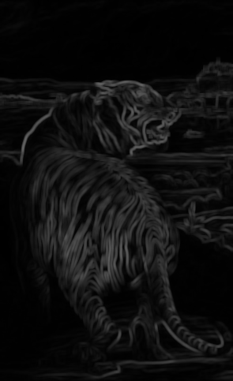
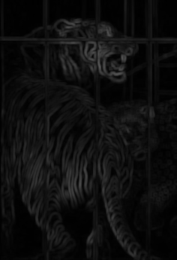
DTM Images
Landseer
Reed
Reed’s
Tiger
Landseer’s
Tiger

Slide 16
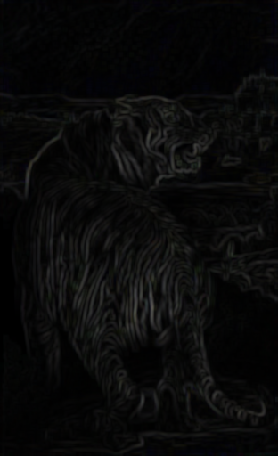
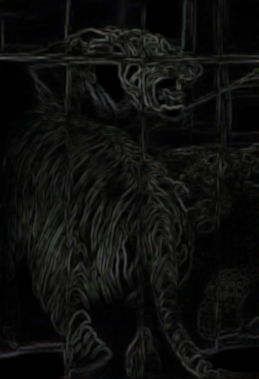
DTM Images
Landseer
Reed
Reed’s Style
on Landseer’s
Tiger
Landseer’s Style on Reed’s
Tiger

Slide 17
Reed’s Tiger
Landseer’s Tiger
Reed’s Style
on Landseer’s Tiger
Landseer’s Style on Reed’s Tiger

Slide 18
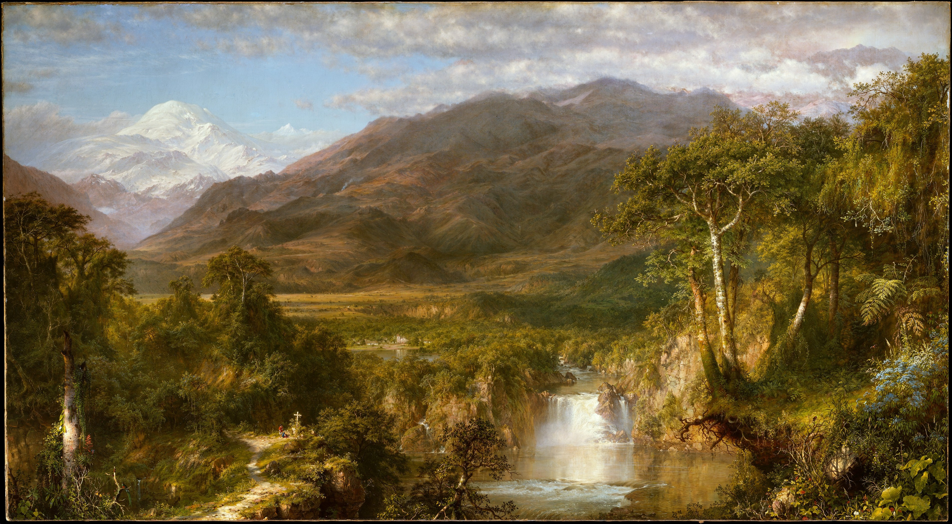
Experiment 2: Using Stylized Images & Entropy

Slide 19
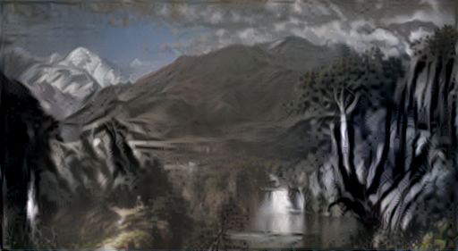
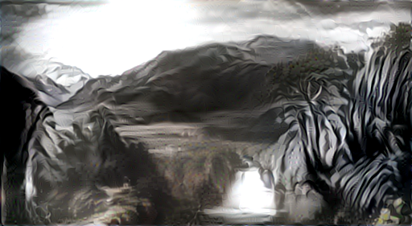

Slide 20
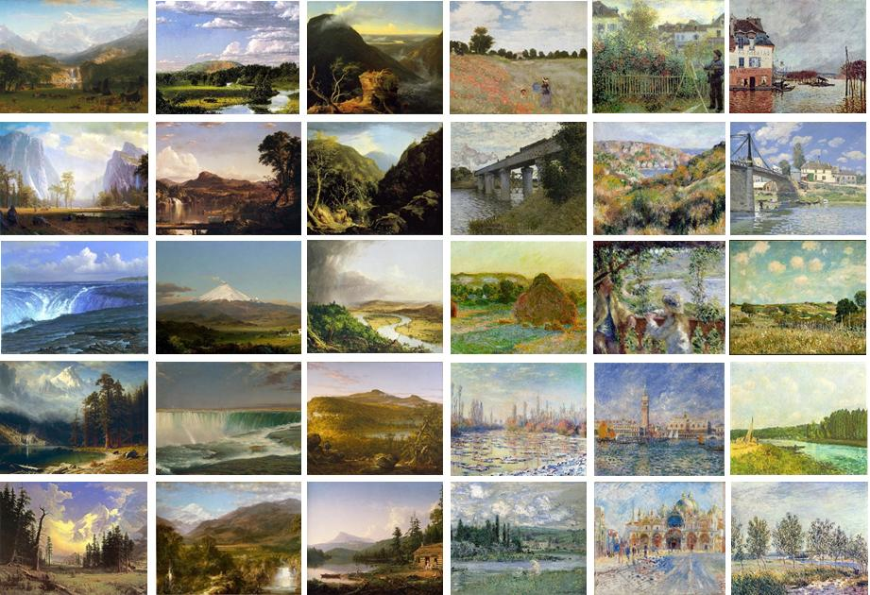
Experiment 2: Pilot Data
Impressionist/Hudson River

Slide 21
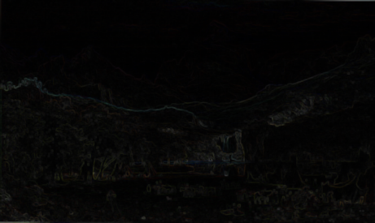
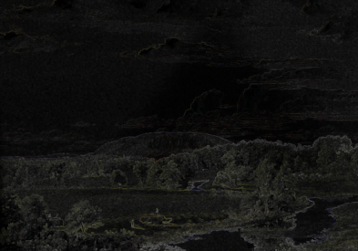
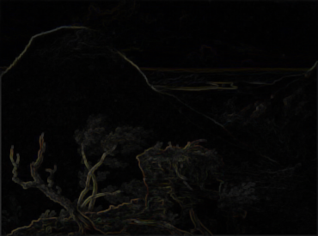
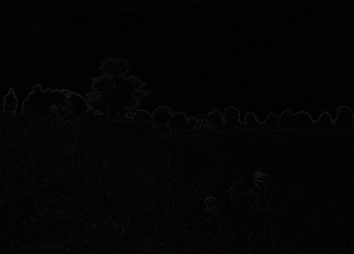
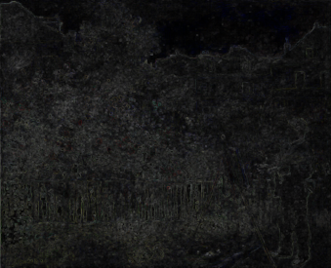
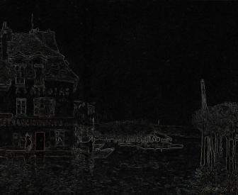
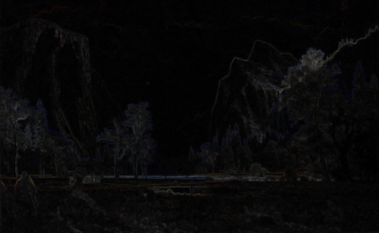
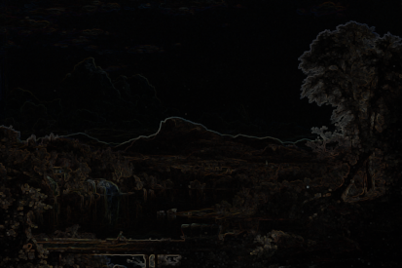
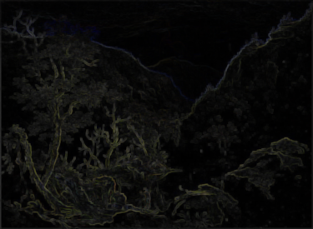
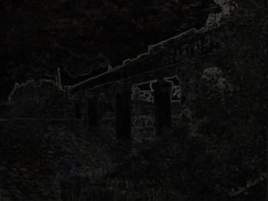
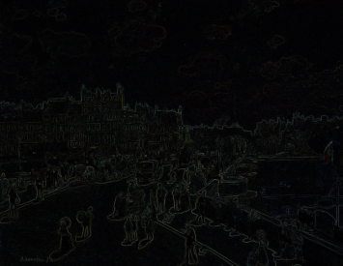
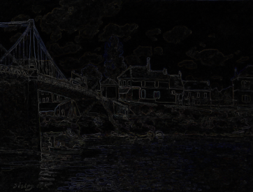
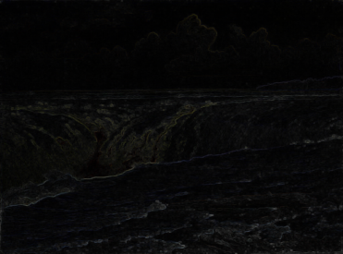
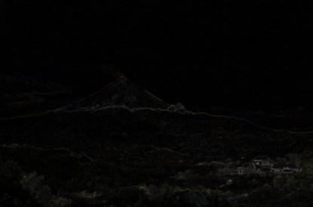
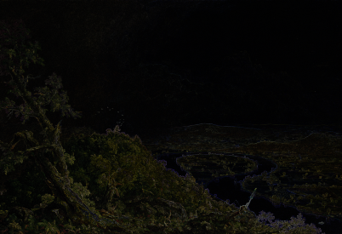
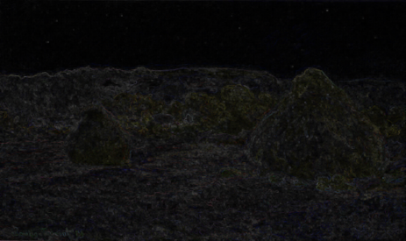
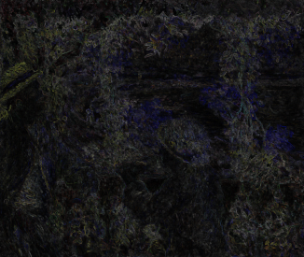
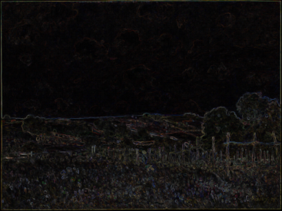
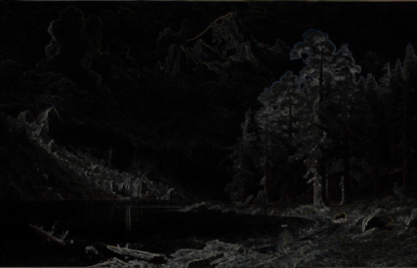
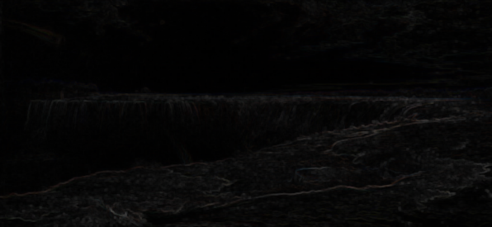
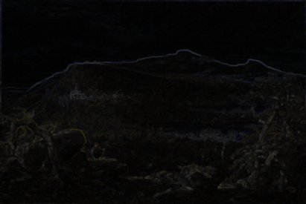
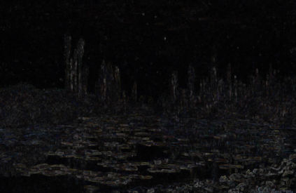
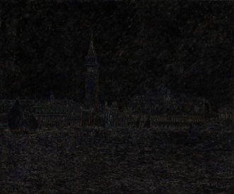
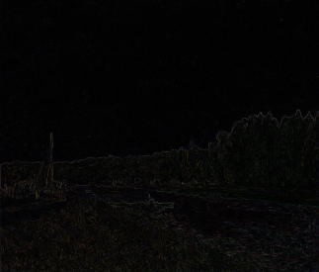
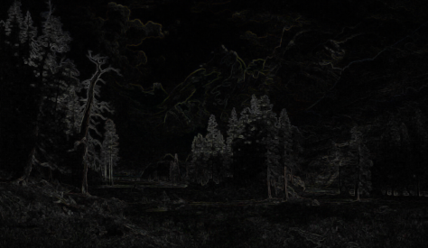
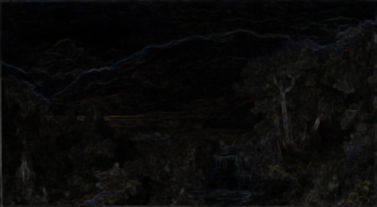
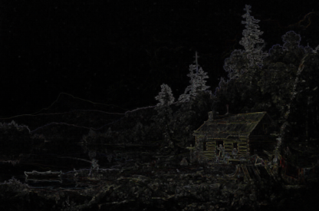




Slide 22
DTM Value Classification
Task 1:
Compute DTM Values (neighborhood 5) for
Two Monet
Two Sisley
Two Renoir
Two Bierstadt
Two Cole
Two Church
Task 2:
Conjecture whether this is possibly a good classifier.

Slide 23




Your turn.
You now have a very particular set of skills, skills you have acquired over a very short time...

Slide 24








Choose from the current collection….

Slide 25

So many options…
...or upload pictures of your own.
We suggest you make the longer side no more than 500 pixels.

